Slide 1

Electromagnetic Radiation
EN 61000-4-3
EMC Basic Standard

Slide 2
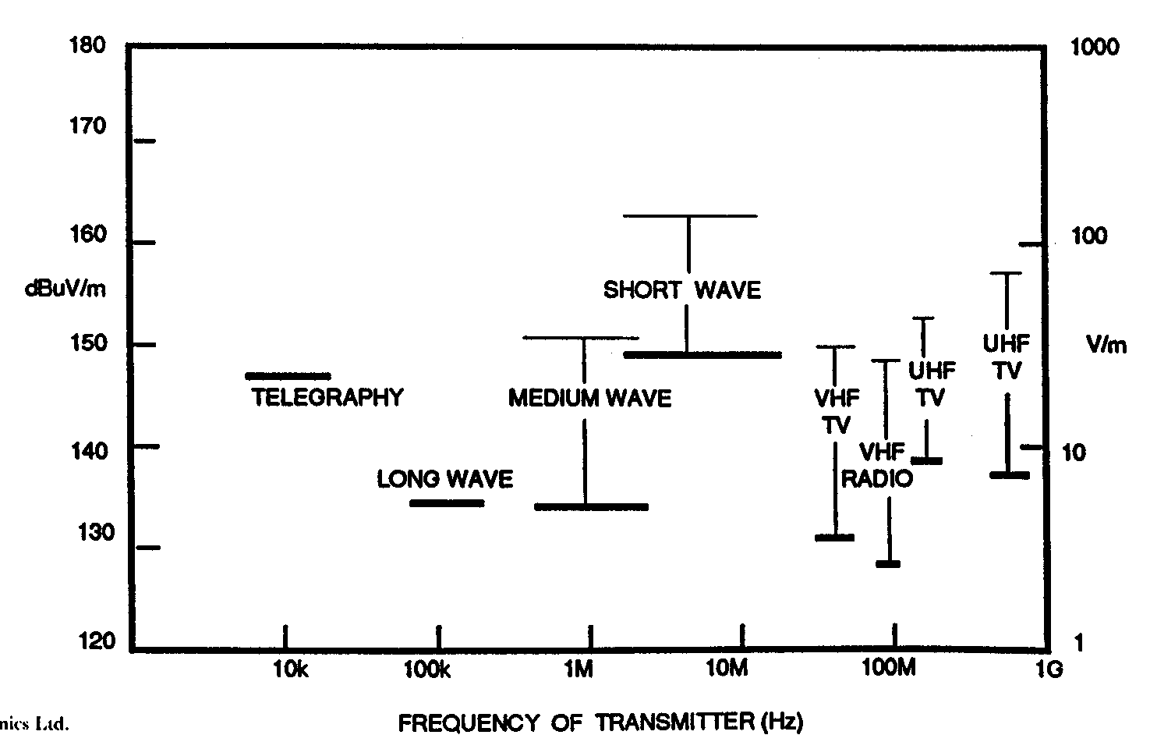
EMC Basic Standard
What is electromagnetic radiation ?
Electromagnetic radiation is mainly caused by man-made transmitters such as TV broadcast transmitter, CB radio, mobile radio, mobile telephony, radar.

Slide 3
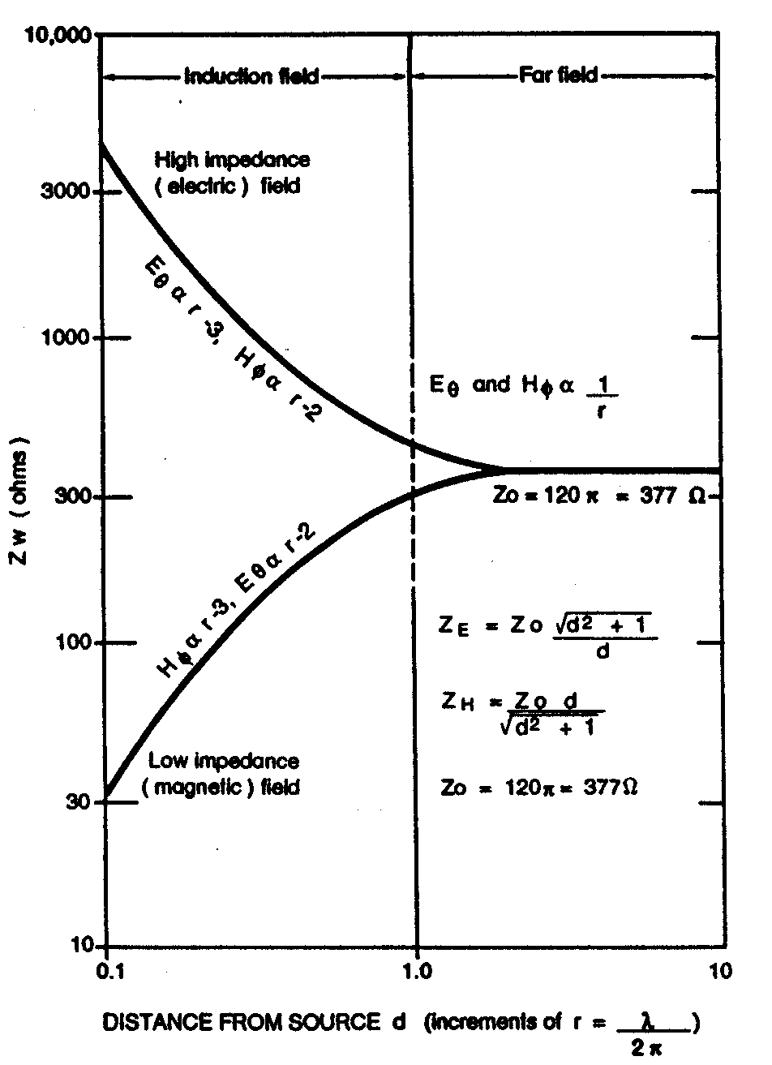
EMC Basic Standard
The Electromagnetic Field

Slide 4
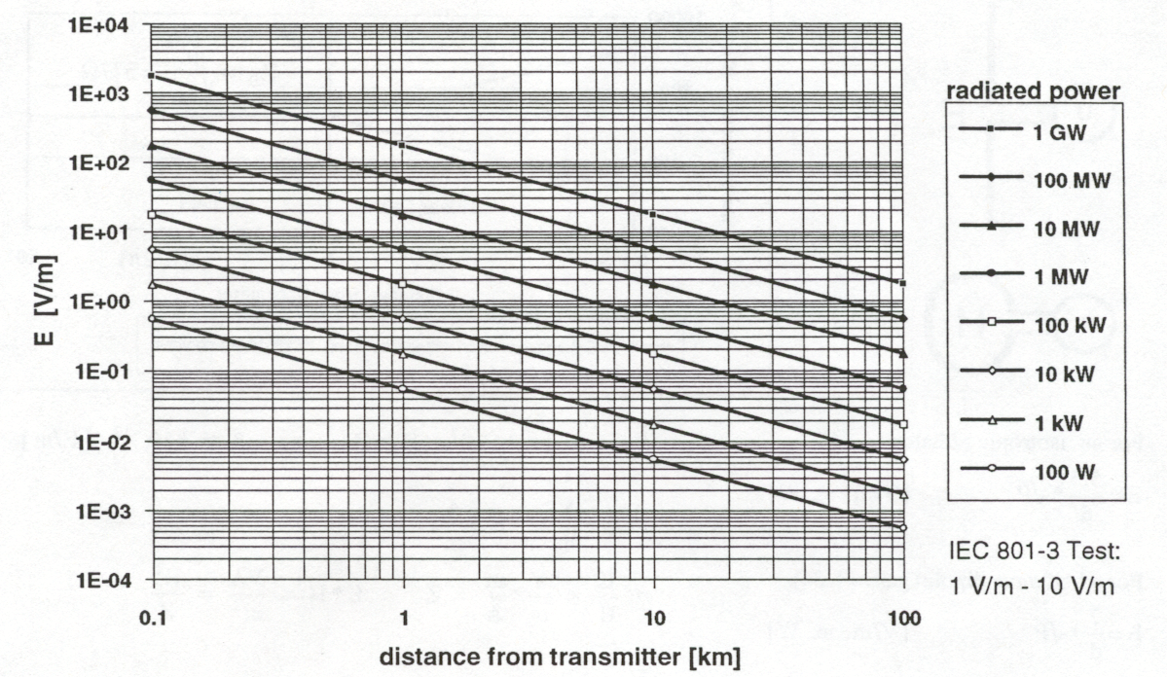
EMC Basic Standard
Radiated Field from a transmitter

Slide 5
EMC Basic Standard
The Electromagnetic Field
Estimation of background noise:
Country side: < 0.1 V/m
City: < 1 V/m
Industry: < 10 V/m
Mobile telephone: < 30 V/m
Broadcast station: > 100 V/m
Basestation mobile telephony > 50 V/m

Slide 6
EMC Basic Standard
Definition:
Anechoic chamber;
Balun
CW
Dipole
Electromagnetic wave
Far field
Field strength
Induction field
Isotropic
Monopole
Polarization
Shield enclosure
Stripline
Spurious Radiation
Sweep

Slide 7
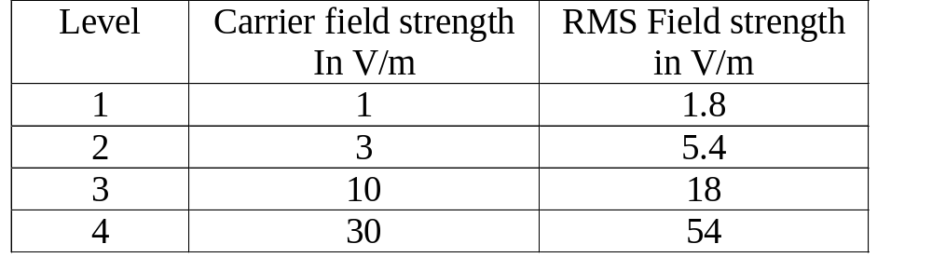
EMC Basic Standard
Test levels

Slide 8
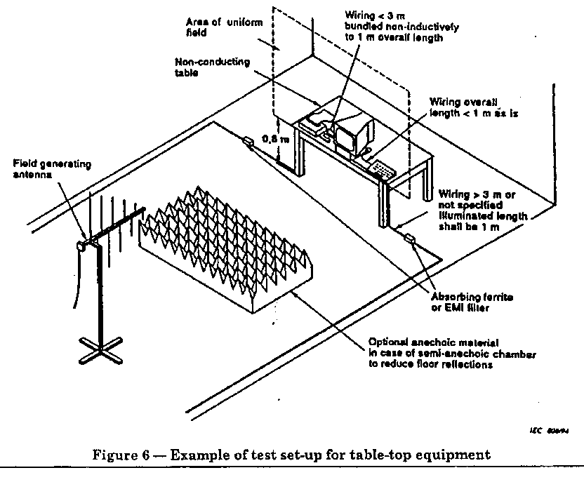
EMC Basic Standard
Typical setup for testing

Slide 9
EMC Basic Standard
Test setup:
Arrangement of table top equipment;
Arrangement of floor standing equipment;
Arrangement of wiring

Slide 10
EMC Basic Standard
Test equipment:
Anechoic Chamber;
EMI filter;
RF signal generator;
Power amplifier;
Field generating antennas;
A horizontal and vertically monitoring antenna;
Associated equipment to record the power level

Slide 11
EMC Basic Standard
Test procedure
Alternative test procedure is to use TEM chamber;A4
Dwell time at each frequency shall be not less than the time necessary for the EUT to be exercised, and be able to respond.
Testing shall be performed according to a test plan which shall be included in the test plan:
The size of the EUT the representative operating conditions of the EUT
Floor stand or table top or combination
The type of test facility and the position of the radiated antennas;
The type of antennas
The rate of sweep of frequency, dwell time and frequency steps;
The test level
The type and number of interconnecting wire and interface port;
The performance criteria which are acceptable;

Slide 12

EMC Basic Standard
Test result and test report

Slide 13
EMC Basic Standard
DISCUSSION

